Slide 1
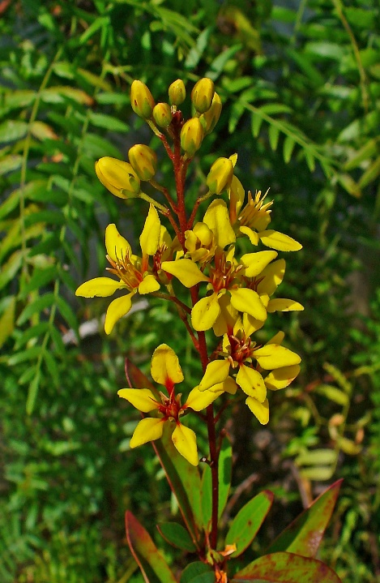
Galphimia glauca in- vitro micropropogation techinque
Keavash Assani, Dr. Ashutosh Sharma
11/18/15
Tecnológico de Monterrey, Campus Querétaro
Degree: Biology (Concentration in Biomedical Sciences) Tissue Culture Lab 3000 Professor: Itzachel del Carmen Arias Buerba

Slide 2
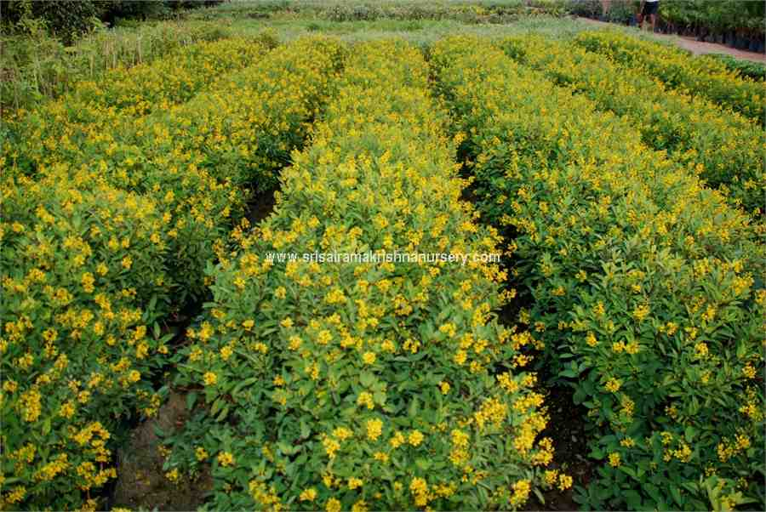
Introduction
Galphimia glauca
Galphimia glauca is a small evergreen tropical shrub commonly found in Mexico and has been used over a long time for medicinal purposes. (Mangas 2006, Tortoriello 1992)
Extinction
Medicinal plant
Central nervous system
Anxiolytic disorders
Sleep deprivation

Slide 3
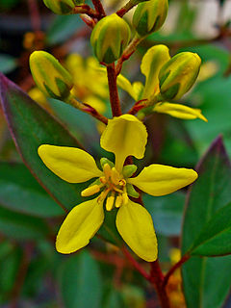
Characteristics
Galphimia appereance is characterized by flowers with yellow petals borne in racemes, either solitary or arranged in groups. Ten fertile stamens surround a tricarpellate ovary with three subulate styles. The globose fruit is a schizocarp that breaks into three 1-seeded cocci. (Anderson 2007)
Known as “Good-Night” (Tortoriello 2015)

Slide 4
Clinical Trial Effectiveness
Related to stress and psychological distress
Folk illnesses such as nervous
Kidneys, uterus, gastric ulcers, traumatic blows, wounds, scars, rheumatism
inflation
Anxiety
Depression
CNS disorders
(Sharma 2012; Herrera 2006; Teut 2006; Abarca 2014; Armando 2014; González 2014; Guzmán 2014).

Slide 5
Conditions for growth
genetic variation
growing conditions
timing and method of harvest
exposure to air light
moisture and type of preservation of the plant materials
Dependent on:

Slide 6
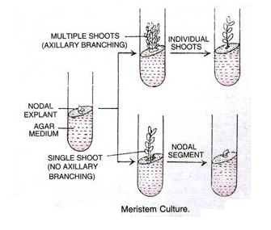
Meristem tissue culture
A standardized method of extraction is essential to reproduce biological activity
Meristematic tissue culture reduces contamination
Efficient in rooting techniques
Free from virus
Rapid clonal multiplication

Slide 7
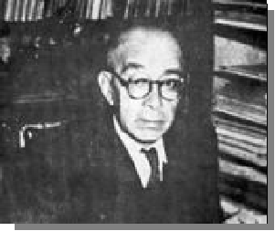
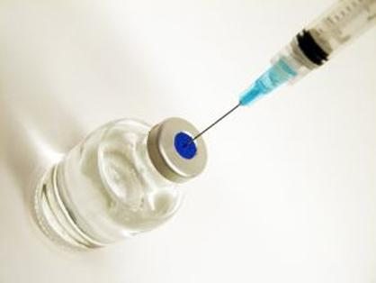
Traditional Use
Mexico traditional medicine
16th century: Francisco Hernández
anti-dysentery, malaria, gastroenteritis and used to help women in labor
20th century:Maximino Martínez
emollient and used for wounds
Treatment for wounds, pimples, postpartum pain, inlfammation, tranquilizar, heart pain
(Tortoriello and Lozoya 2007; Guzmán 2014)
(Hernández 1959, Biblioteca Digital de la Medicina 2009)
(Gómez and Chong 1985; Ortíz 1986).

Slide 8
Bioactive Constituents of G. Glauca
Nor-seco-triterpenoids
Fatty acids
Flavenols
Alkenes
Metabolites
Many of the bioactive compounds such as the nor-seco-triterpenoids that display anxiolytic properties have been found in the aerial parts of the plant (González 2014).

Slide 9
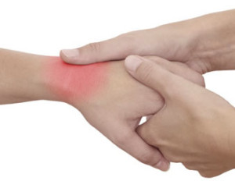
Many also display pharmacological effects:
anti-inflammatory
anti-malaric
anti-allergic
anti-asthmatic activities
Diarrhea
Gastroenteritis
Dysentery
(Tortoriello 2015 ,Diaz 1976; Dorsch et al 1992; Neszmélyi et al. 1993; Camacho 1997 and Sharma et al. 2012).

Slide 10
Galphimines Most Active
Galphimine-A (G-A)
Most abundant anxiolytic compound in this plant
Galphimine-E (G-E)
Overall the most abundant galphimine
Inactive in its natural form, can be converted to G-A.
Galphimine-B (G-B)
Most potent anxiolytic galphimine
Found at very low concentrations
Methodologically complicated to isolate and purify
(González 2014).
(Abarca 2014, Hierra 2006).
(Drosh et al. 1992, A. Neszmélyi et. Al 2007).

Slide 11
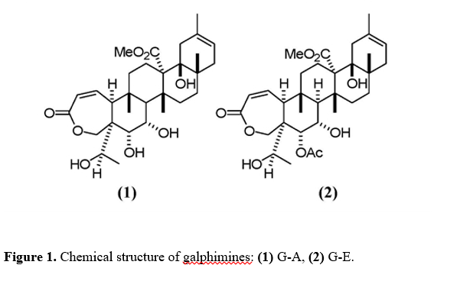

Slide 12
Gallic acid, methyl gallate, and tetragalloylquinic acid
Anti-asthmatic effects
Tetragalloylquinic acid most active
Flavenols: Kaempferol, Quercetin
Decrease anxiety
Inhibit the production of nitrates and prostaglandins-E2
Diminish cellular infiltration into rat granuloma air pouch
Reduce the activity of nuclear factor (NF)-kappaβ and NF-kappaβ-dependent pro-inflammatory gene activity.

Slide 13
Background
In-vitro development of G. glauca
IAA and Kinetin in MS medium on the Galphimia explants
From this experiment they were able to grow 20 shoots from a single bud within 60 days of culturing
A year later they extracted the secondary metabolites and obtained triterpenoid galphimine-B

Slide 14
Other studies of G. glauca
Callus induction and cell suspension cultures
triterpene production
Two-stage culture process
maximize the biomass growth and G-B production.
Analyze effect of calcium alginate beads
G-B accumulation could be examined
Analyze the effects of G. glauca clinically and in vitro
Lack of studies on micropropogation of G. glauca

Slide 15
Hormones | Effects
Auxins | initiate root
Abscisic acid | inhibitory effects in plant tissue culture
Cytokinins | Initiate shoot growth
Gibberellins. | inhibitory effects in plant tissue culture

Slide 16
Auxins | indole-3-acetic acid (IAA) indole-3-butyric acid (IBA), 2,4-dichlorophenoxyacetic acid (2,4-D) 1-naphthalenacetic acid (NAA)
Cyokinins | 2iP Kinetin BA BAP

Slide 17
Studies on Hormones-Auxins
IBA has shown to be more stable than IAA in plant tissue culture and thus is more efficient in promoting root growth (Tiberia 2015).
2,4-D is a known callus inducer
NAA has been shown in successful formation of adventitious roots and is an obligatory phase of vegetative propagation in many woody plants and is stable at room temperature (Tiberia 2015).
combining two auxins it can be more efficient in root proliferation than only using one auxin (Osuna 2012).

Slide 18
Studies on Hormones-Cytokinins
2ip has been used in vitro to support in vitro propagation of micro shoot cultures from shoot tips and has been commonly used with zeatin. (Sigma Alrdich 2015).
Kinetin is an adenine/type cytokinins that is used to induce formation of callus and to regenerate plant tissues from callus (Sigma Aldrich 2015).

Slide 19
Root growth:
include cytokinins with auxins
Equal amounts form callus
Cytokinins at a lower level than auxins for root induction
Efficient levels of root proliferation with a 1/4th and 1/3rd concentration of cytokinins in relation to auxins
(Tiberia 2015; Sadeghi 2014).

Slide 20
Justification
Traditionally used as a sedative as well as a medicine to treat neurological disorders.
Triterpene Galphimine-B has shown anxiolytic, sedative, spasmolytic, and other neurological properties
The production of Galphimia glauca through in vitro micropropogation is desired to obtain the triterpene/nor-secofriedelanes.
Few micropropogation techniques

Slide 21
Hypothesis
It is our hypothesis that the auxins NAA and IBA at different molar concentrations will produce varying root number and length growth. We hypothesize that together the two auxins will be better than with concentrations with only one of the auxins and also that extremes of the compounds will inhibit root formation.

Slide 22
Main Objective
To obtain G. glauca in vitro with the best rooting possible, using meristem cultures.

Slide 23
Specific Objectives
1. Medium preparation
2. Micropropagacion
3. Medium with varying concentrations of IBA and NAA with half strength MS solutions and 1/3th concentration of cytokinins 2ip and Kinetin in relation to the auxins
4. Root induction
5. Data analysis

Slide 24
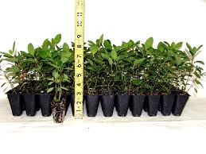
Method and Materials
Obtain plant materials from Dr. Ashutosh Sharma that had previously been scarified with ethanol
Merisetmatic tissue collected and used produce 250 shoots from four plants
Shoot Production: MS media of macronutrients, and micronutrients full strength, vitamins, salts, sucrose and 1.5 grams/L activated carbon
Measure length of plant shoots once per week and subculture every two weeks (4 total)

Slide 25
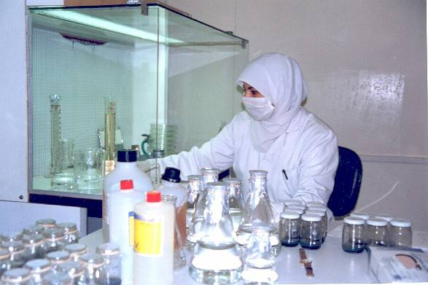
Multiple Concentrations of 0 uM, 4 uM, 10 uM, and 40 uM of both IBA and NAA mixes were mixed into the solutions with a 1/3 the concentration of cytokinins 2ip and kinetin.
Basal Media Prep: 50 % MS salts, macronutrients, micronutrients, and vitamins, without vegetable carbon.

Slide 26
 |  | IBA
 |  | 0 uM | 1 uM | 4 uM | 10 uM | 40 uM
NAA | 0 uM | 0/0 | 0/1 | 0/4 | 0/10 | 0/40
 | 1uM | 1/0 | 1/1 | ¼ | 1/10 | 1/40
 | 4 uM | 4/0 | 4/1 | 4/4 | 4/10 | 4/40
 | 10 uM | 10/0 | 10/1 | 10/4 | 10/10 | 10/40
 | 40 uM | 40/0 | 40/1 | 40/4 | 40/10 | 40/40

Slide 27
Eight plants were used for each concentration.
The roots were measured using a compass every 2 days for 3 weeks and the number of roots were counted.
Determine best rooting hormone combination

Slide 28
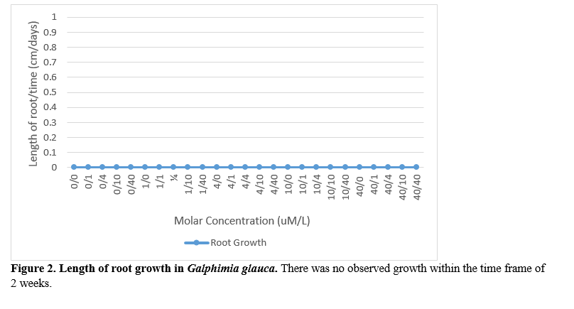
Results
The only sign of roots was the swelling of the bottom of the shoots, which indicates that the roots are about to be induced.

Slide 29
Since no roots were observed, no number of roots were able to be counted. The length of the shoots in the flask has remained the same and the number of leaves per plant in each flask has also remained the same.

Slide 30
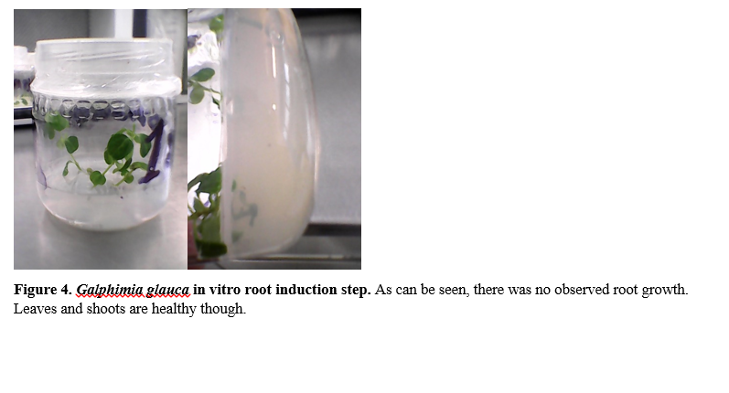
The shoots are healthy and but there is no observed root growth. The shoots can be shown to begin swelling at the bottom of the shoot.

Slide 31
Discussion
No root induction
Swelling of shoot bottoms
Study on inhibitory effects of IAA by Eliasson
High levels of IAA, IBA is very close in structure
Reversed by cobalt and silver ions
(Eliasson 1989).
Effects of plant hormones on G. glauca unknown
Promote or inhibit growth

Slide 32
Auxin development required for:
Root elongation
Gravity Response
Lateral root development
(Ktekar and Geissler 1980; Muday and Haworth 1994)
Previous study with IBA and Kintetin
IBA .3 mg/L
Kinetin .1 mg/L
Polyvinylpolypyrrolidone 1 mg/L
30 days
(Rojas 2005)

Slide 33
Possible Problems
Time
Type of hormones used
Cytokinin interaction with auxins
Activated carbon in shoot phase but not root
Shown to induce radicate quality of roots (Chen 2012)

Slide 34
Conclusion
Main objective not reached
The results shown do not necessarily mean that the plants will not grow roots.
Infected roots due to auxins potentially
No significant data collected
Lack of root induction
Further Studies
Different horones
No cytokinins
Activated carbon effect

Slide 35
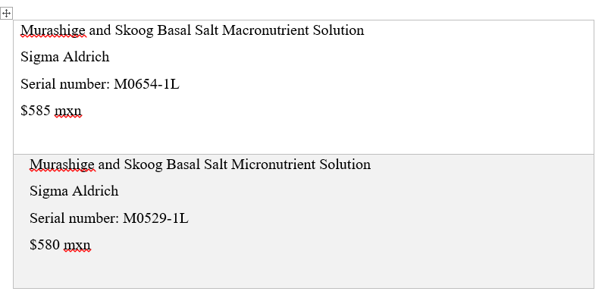
Cost of experiment

Slide 36
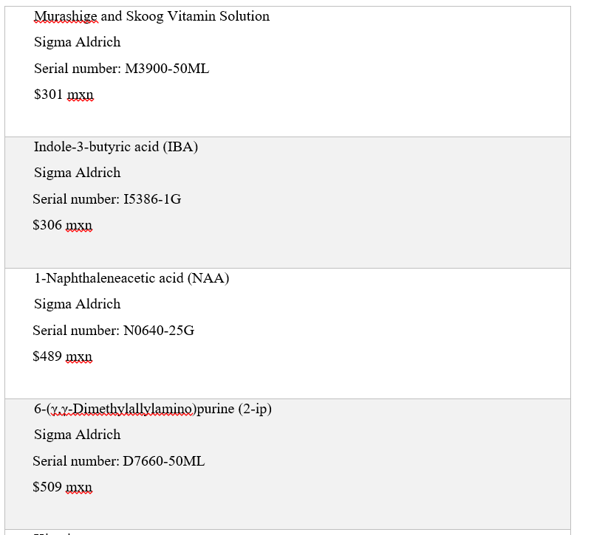

Slide 37
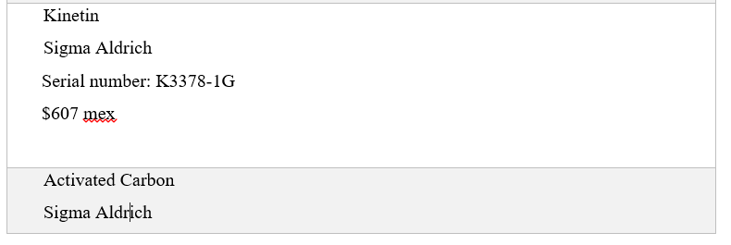
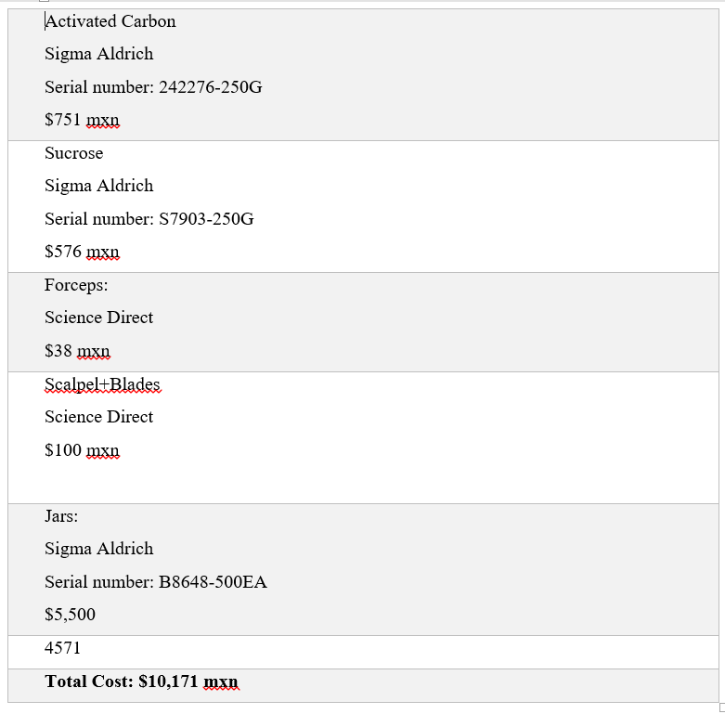

Slide 39
Thank you for your attention
Questions?

Slide 40
References
A Neszmélyi, et al. "Tetragalloylquinic Acid, the Major Antiasthmatic Principle of Galphimia Glauca." Planta Medica59.2 (2007): 164-7. Print.
Abarca Vargas, Rodolfo, et al. "Pharmacokinetic Study in Mice of Galphimine-A, an Anxiolytic Compound from Galphimia Glauca." Molecules (Basel, Switzerland) 19.3 (2014): 3120-34. Print.
Anderson, C. (2007) Revision of Galphimia (Malphighiacea). University of Michigan Herbarium.
Armando Herrera-Arellano, et al. "Therapeutic Effectiveness of Galphimia glauca Vs. Lorazepam in Generalized Anxiety Disorder. A Controlled 15-Week Clinical Trial." Planta Medica78.14 (2012): 1529-35.
Armando Herrera-Arellano, et al. "Therapeutic Effectiveness of Galphimia Glauca Vs. Lorazepam in Generalized Anxiety Disorder. A Controlled 15-Week Clinical Trial." Planta Medica78.14 (2012): 1529-35. Print.
Biblioteca Digital De La Medicina, 2009. Web. 30 Oct. 2015.
Cardoso, A. Et al (2004) Isolation of Nor-secofriedelanes from the Sedative Extracts of Galphimia glauca. Departamento de Farmacia, Facultad de Quı ́mica, Universidad Nacional Autónoma.
Diaz. Uso de las Plantas Medicinales de México. Instituto Mexicano para el Estudio de las Plantas MedicinalesEditorial Libros de México, Mexico (1976) p. 329
Dorsch W, Bittinger M, Kaas A, Müller A, Kreher B, Wagner H. Antiasthmatic effects of Galphimia glauca, gallic acid and related compounds prevent allergen and platelet-activating factor-induced bronchial obstruction as well as bronchial hyperreactivity in guinea pigs. Int Arch Allergy Immunol. 1992; 97 1-7
Gómez, L., Chong, E., 1985. Conocimiento y Usos de la Flora de Amatlán, Municipio de Tepoztlán, Morelos. Tesis. Facultad de Ciencias, UNAM. México, p. 91.
González-Cortazar, Manasés, et al. "Anti-Inflammatory Activity and Chemical Profile of Galphimia Glauca." Planta Medica80.1 (2014): 90. Print.
Guzman, L. (2014) Medicinal plants for the treatment of “nervios”, anxiety, and depression in Mexican Traditional Medicine. Revista Brasileira de Farmacognosia
Guzman, L. et al (2009) SEDATIVE ACTIVITY OF SOME PLANTS USED IN MEXICO TO TREAT INSOMNIA. Research Gate.
Hernández, F. 1959. HItoria de las plantas de Nueva España, In: Historia Natural de Nueva España Volumenes I y II, Obras Comletas Tomos II y III, Universidad Nacional Autónoma de México, México. P 476. And p. 554.
Herrera, A. (2007) Efficacy and tolerability of a standarized Herbal Prodcut from Galphimia Glauca on generalized anxiety disorder. A randomized, double blind clinical trial controlled with lorazepam. Planta Med
Herrera-Ruiz, M., et al. "Anxiolytic and Antidepressant-Like Activity of a Standardized Extract from Galphimia Glauca."Phytomedicine 13.1 (2006): 23-8. Print.
Lidia Osuna, et al. "Immobilization of Galphimia Glauca Plant Cell Suspensions for the Production of Enhanced Amounts of Galphimine-B." Planta Medica 74.1 (2008): 94-9. Print.
Linares et al., 1995 Linares, M.E., Flores P.B., Bye R., 1995. Selección de Plantas Medicinales de México. Limusa-Noriega, México.
Mangas, Susana, et al. "The Effect of Methyl Jasmonate on Triterpene and Sterol Metabolisms of Centella Asiatica, Ruscus Aculeatus and Galphimia glauca Cultured Plants."Phytochemistry 67.18 (2006): 2041-9.
Nader B, Cardoso A, Iturriaga G, Pereda-Miranda R, Villarreal M L. Genetic transformation of Galphimia glauca byAgrobacterium rhizhogenes and the production of norfriedelanes. Planta Med. 2004; 70 1174-9
Ortíz, S. A., 1986. Contribución al conocimiento de las plantas medicinales de Xoxocotla, Morelos. Tesis. Facultad de Ciencias Biológicas, UAEM, México.
Osuna L, Pereda-Miranda R, Tortoriello J, Villarreal M L. Production of the sedative triterpene galphimine B inGalphimia glauca tissue culture. Planta Med. 1999; 65 149-52

Slide 41
Osuna L, Pereda-Miranda R, Villarreal M L. In vitro production of sedative galphimine B by cell suspension cultures of Galphimia glauca . Biotech Lett. 2002; 24 257-61
Sharma, Ashutosh, et al. "A Comparison on the Metabolic Profiling of the Mexican Anxiolytic and Sedative Plant Galphimia Glauca Four Years Later." Journal of ethnopharmacology 141.3 (2012): 964. Print.
Sharma, Ashutosh, et al. "DNA Barcoding of the Mexican Sedative and Anxiolytic Plant Galphimia Glauca." Journal of ethnopharmacology 144.2 (2012): 371-8. Print.
Teut, Michael, et al. "A Homoeopathic Proving of Galphimia Glauca." Forschende Komplementärmedizin (2006) 15.4 (2008): 211. Print.
Tortoriello J, Romero O. Plants used by Mexican traditional medicine with presumable sedative properties: an ethnobotanical approach. Arch Med Res 1992; 23; 111-6
Tortoriello J., and Lozoya X. "Effect of Galphimia Glauca Methanolic Extract on Neuropharmacological Tests." Planta Medica 58.3 (2007): 234-6. Print.
Tortoriello J, Lozoya X. Effect of Galphimia glauca methanolic extract on neuropharmacological tests. Planta Med. 1992; 58 234-6
Tortoriello J, Ortega A, Herrera-Ruiz M, Trujillo J, Reyes-Vazquez C. Galphimine-B modifies electrical activity of ventral tegmental area neurons in rats. Planta Med. 1998; 64 309-13
Tortoriello J, Ortega A. Sedative effects of galphimine B, a nor-seco-triterpenoid from Galphimia glauca . Planta Med. 1993; 59 398-400
Tortoriello, et al. "New Anxiolytic Phytopharmaceutical Elaborated with the Standardized Extract of Galphimia Glauca." Planta Medica 78.11 (2012): PI414. Print.
Tortoriello, J. et al (2011) New Anxiolytic Phytopharmaceutical Elaborated with the Standardized Extract of Galphimia glauca.
Tortoriello, J. et al (2015) Aplicación clínica de un ansiolítico obtenido de Galphimia glauca. 1 congreso Iberoamericano de fitoterapia.
Toscano R A, Ortega A, Maldonado E, Gaviño R, Lozoya X, Tortoriello J. Structure of galphimine B. Acta Crystallogr. 1993; C49 774-6

