Slide 1
Hyptis suaveolans conservation genetics and cross-genera transferability of the Lamiaceae family using e-microsatellite markers
Keavash Assani A01672871 * Diana Cecilia Ruiz Nava A01350060 * Isabel Fernandez Lopez A01152280 * Daniel Velez Wiesner A01206144 * Pablo Luis Godinez Mendoza A01204148
Advisor: Dr. Victor Rodriguez Garcia

Slide 2
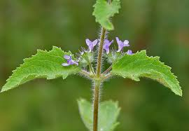
Introduction:
There are 7000 species of Lamiaceae and 240-265 genera. Lamiaceae is a very diverse family. There are 280 species of Hyptis in the world, and 35 species of Hyptis present in Mexico, 17 being endemic (48.5%) (Gordillo 2013) from Generos de Lamiaceae de Mexico
The Lamiaceae family contains many high-valued medicinal, aromatic and ornamental plant species, several of which are under high pressure for collection and commercial use.
Hyptis suaveolans is a very common plant widely distributed in Mexico, northern Australia, eastern South America, parts of western Africa and some places in Asia. (Eol website)
Dicot
Annual herb
Occupies roadsides, rail tracks, wastelands, watercourses, pastures, open forests where soil is well drained
Classified as a wee

Slide 3
Pharmecuetical Properties of H. suaveolans
Anti-inflammatory and wound healing
Antibacterial
Abscesses and haemorrhoids
Stimulant, carminative, suorific an lactogogue (India)
Infections of uterous
Stomach ache
Purify blood
Antispasmodic, anti-rheumatic, antisoporific (Philippines)
(from pharological review of hyptis suaveolans)

Slide 4
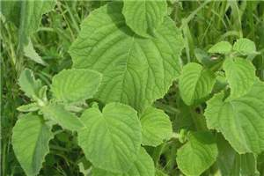
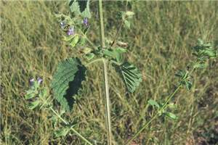
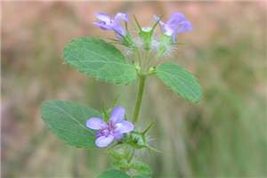
Phytoconstituents
Essential oils
Alkaloids
Flavenoids
Phenols
Saponins
Terpenes
Sterols
Oils found in leaves, shoots, and seeds
Oils can differ based on geographical origin of plants

Slide 5
Purpose and Reasoning/Hypothesis
Due to the loss of genetic diversity of many genetic resources our goal is to create an enriched genomic library by identifying simple sequence repeats and microsatellite markers of medically important species within the Lamiaceae family
It is our hypothesis that identifying the e-satellite markers will allow us to find identifiable markers that will contribute to the conservation of the species. By using cross genera analysis's we hypothesize we will find sequences in Hyptis suaveolans that are cross-genera transferable in other species of the Lamiaceae.

Slide 6
Antecedents
Previous studies
Cross-genera transferable e-microsatellite markers for 12 genera of the Lamiaceae family
Identified that e-microsatellites are an efficient and cost-effective procedure that has proved to be a useful marker for population genetic structure, parentage analysis and genetic resources assessment as ell as molecular phylogeny studies.
Previous studies on the cross-genera transferable e-microsatellite markers has been performed on 12 genera of the Lamiaceae family
Used expressed sequence tags is much more cost effective and efficient relative to conventional enrichement procedures which are expensive and cross genera transferability of these microsatellite markers is low.
A total of 12432 ESTs were identified from Salvia Fruticosa, S. miltiorrhiza, S. sclarea, Strnogyne rugose
Half of ESTs were redundant
Tetranucleotide microsatellite motifs were most common
Cross-genera transferable e-microsatellites were identified and it was identified that the LAB primer pairs decresased as evolutionary distance between the source and target species increased.

Slide 7
Importance
Cross-genera transferable microsatellites primer pairs are important sources for genetic studies of the species in the Lamiaceae family
Potentials for use to use in comparative analyses of population structure and genomic studies as well as to facilitate comparative linkage mapping in the genus studied
Potential to identify commercially important genotypes and to select high-yielding ones for development of new varieties (24-29 of lamiaceae paper)

Slide 8
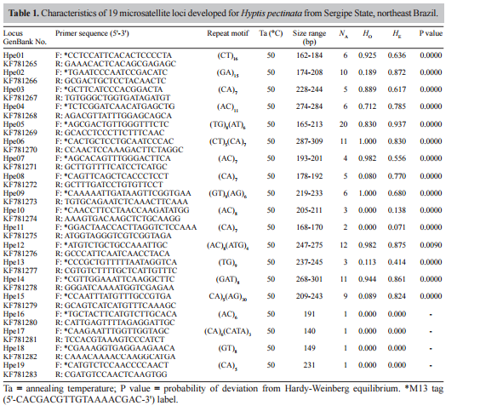
Previous Studies cont…
Development and characterization of novel microsatellite markers in Hyptis pectinata (Lamiaceae)
This study identified 113 alleles with a mean of 7.52 alleles per locus.
Primers were developed as tools for accessing the genetic diversity of the germplasm collection
Importance
May be useful for other studies involving the genus Hyptus
Provides numerous primer sequences that could be used within this experiement

Slide 9
Previous studies cont…
Variation in the Frequency and Extent of Hybridization between Leucosceptrum japonicumand L. stellipilum (Lamiaceae) in the Central Japanese Mainland
Development of microsatellite markers forLeucosceptrum japonicum and L. stellipilum(Lamiaceae)¹
In these studies microsatellite primers for amplifying microsatellite loci for two Lamiaceae species Leucosceptrum japonicum and L. stellipilum were used to study hyprid zones between species
Importance:
The primers were neutral and may be able to be used in our study. It identified sequences that are important to amplify microsatellite loci.

Slide 10
Objectives
Identify ESTs within Hyptis suaveolans
Design e-microsatellite primers
Discover positively amplified primers
Identify and develop e-microsatellite markers in genome
Identify cross-genra transferable microsatellites in Lamiaceae family

Slide 11
Methods and Materials
Extract genomic DNA from fresh or dried leaves of Hyptis suaveloens with Isolate II Plant DNA Kit
Design ESTs (expressed sequence tags) from GenBank
Collect species from herbarium

Slide 12
Assemble ESTs into contiguous sequences (contigs) using Sequencher software
Identify redundant EST sequcnes
Use Tandem Repeats Analyzer 1.5 program to anylize individual contigs

Slide 13
Use PRIMER3 to design e-microsatellite primer
Use gradient PCR to find prime annealing temperature of primers
Identify what primers display a positive amplification using gel electrophoresis

Slide 14
Confirmation of e-microsatellites in amplified products using QIAgen purification kit
Amplfy using InsTAclone cloning kit/TransformAid protocol vecotrs
Use ribosomal spacers (ITS1 and ITS2) for phylogenic analyses of taxa of the Lamiaceae
Extract plasmds with plasmid isolation kit

Slide 15
References

