Slide 1
Southern blot method
Wendolyn González
Luis González
Verónica Sánchez
José Merino Gallardo
Laura Enriquez
Pablo Cesar Martínez
Sebastián Aguirre
María José Vázquez
Cesar
Katherine Torres
María Fernanda Martínez

Slide 2
Enzymatic amplification of β-globin genomic sequences and restriction site analysis for diagnosis of sickle cell anemia
Randall K. Saiki; Stephen Scharf; Fred Faloona, Kary B. Mullis

Slide 3
Introduction to the problem
Two new methods were used in prenatal rapid diagnosis for sickle cell anemia.
First the primer-mediated enzymatic amplification of specific B-globin target sequences in genomic DNA
Second, the presence of βa and βs alleles is determined by restriction endonuclease digestión of an end-labeled oligonucleotide probe hybridized in solution.

Slide 4
SOUTHERN BLOT METHOD
Cut DNA with restriction enzymes
Electrophoresis (Smear of DNA)
Transfer to a filter paper
Hybridize with probe

Slide 5
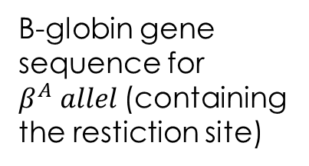
Cut DNA with restriction enzymes
B-globin gene sequence for $β^{A} allel$(containing the restiction site)
Restriction enzyme: Dde I
Hybridization with an end-labelled oligomer to identify the sequences containing the site.

Slide 6
Sequence of PCR
New synthetized DNA strands
Cycles of denaturation
Primer annealing
Extension result in exponential accumulation by primers

Slide 7
Sequence of PCR
To amplified the β-globin gene segment they used 20-base oligonucleotide primers that flank the región to be amplified
They used 2 steps for determining the β-globin genotype of human genomic DNA samples:
From β-globin gene sequence spanning the polymorphic Dde I restriction site diagnostic of the βa allele is amplified
The presence of Dde I restriction site in the amplified DNA simple is determined by solution hybridization with endolabeled oligomer

Slide 8
The PC04 (primer) is complementary to the positive stand and the PC03 is complementary to the negative strand.
The annealing of PC04 to the positive strand of denatured genomic DNA, next is the extension with a fragment of Escherichia coli DNA plimerase I ddt = to the synthesis of the negative strand.
PC03 creates a new positive strand

Slide 9
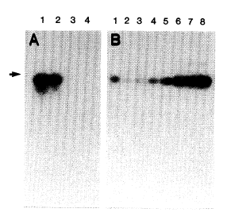

Slide 10
Transfer to a filter paper.
After neutralization and transfer to Genetrans nylon membrane, the filter was “prehybridized” in 10 ml 3x SSPE, 5x DET, 0.5 percent SDS and 30 percent formamide for 4 hours at 42°C.

Slide 11
RFLP METHOD
Oligomer
Restriction
Used it to distinguish
the β^A and β^S
alleles
The genomic sample was amplified and analised by Southem blot
Variation of RFLP

Slide 12
They end-labeled with
P^32 oligonucleotide probe (RS06)
complementary to de β- globin gene
β^A allele
β^S allele
Sequence
contains
mutation
Dde restriction side
Dde restriction side ADSENT
Dde restriction side
Hinf I site
next
Digestion with Dde I and Hinf I allowed them to distinguish between the two alleles

Slide 13
Cloned B-globin DNA was placed in a microcentrifuge tube adjusted to 30 µl with TE buffer , overlaid with 0.1 ml of mineral oil.
DNA was denatured by heating for 5 to 10 min at 95°C.
10 µl of 0.6M NaCl with 0.02 pmol of phosphorylated RS06 probe oligomer, were added and annealed for 60 min at 56°C.
5 µl of 100 mM MgCl2 and 1 µl of Dde I were added and incubated for 20 min at 56°C
1 µl of Hinf I was added, and digestion was continued for 20 min at 56°C.
Addition of 4 µl of 100 mM EDTA and 6 µl of tracking dye to a final volume of 61 µll. (Reaction terminated)
Until the bromophenol blue dye front reached 3 cm; a portion was applied to a polyacrylamide minigel and subected to electrophoresis for 1 hr.
Lane 1: 6 ng og B^A
Lane 2: 3 ng of B^A and 3 ng of B^S.
Lane 3: 6 ng of B^S

Slide 15
$β^{A}$ allele
$β^{S}$ allele
Dde I
Affects the restriction site for Hinf I
there’s an A-A mismatch
No effect in the digestion with Dde I
Digestion
With
Hinf I
The sequence remain intact
Causing
A cut in the sequence making it of 3 nucleotides.
Digestion
with Hinf I
No effect and the size of the sequence is about 8 nucleotides

Slide 16
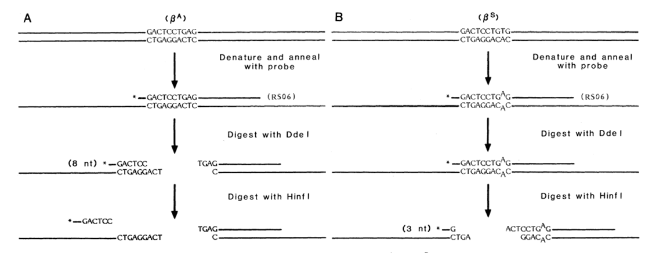

Slide 17
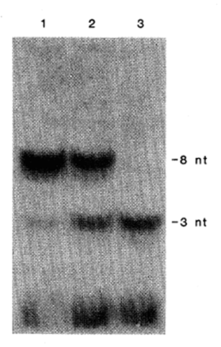
They make an electrophoresis to show those results

Slide 18
1 pmol of phosphorylated in 10 ml of the same buffer
Carried out for 18 houers at 42ºC
Wash the filter twice in 2x SSPE .1%sodium dodecyl sulfate at room temperature dor 30 minutes.
Autoradiographed at 70ºC for 2 hours with a single intensification screen

Slide 19
DNA`s isolated fro the cell lines molt 4, SC01 and GM2064 respectively.
Molt 4 is homozygous for the normal wild type allele og B-globin is homozygous for the sickle cell allel.
GM2064 is a cell line which the b-and & globin genes have been deleted.
Contains 36 ng of molt4 DNA that was not PCR amplified.

Slide 20
Overview
The allele gives homogozygosity sickle cell disease, gene on β - globin S allele is the transforms an SSA To replace T in the sixth codon “A” poicion 2 β.
Southern blot analysis detected the presence of DNA in a complex mixture, for this the techniques described above are used to complete the probe hbridacion and get the sought.

Slide 21
References:
K, R., 1985. K., R., 1985. Enzymatic Amplification of $\beta $-Globin Genomic Sequences and Restriction Site Analisys for Diagnosis Cell Anemia.. Stor, 230(4732), pp. 1350-1354.

